Slide 1


AI-Powered Question Paper Generation Based On Bloom’s Taxonomy
By
Yash Bongirwar 112103026
Yash Diwane112103038
Devanshu Gupta112103035
Under the Supervision of
Dr. Yashodhara V. Haribhakta
3th May 2025

Slide 2
AI-Powered Question Paper Generation Based On Bloom’s Taxonomy
Haribhakta
for automating the process of question paper generation
Leveraging the power of AI
for automating the process of question paper generation
By
Yash Bongirwar 112103026
Yash Diwane112103038
Devanshu Gupta112103035
Under the Supervision of
Dr. Yashodhara V. Haribhakta
3th May 2025

Slide 3
AI-Powered Question Paper Generation Based On Bloom’s Taxonomy
Haribhakta
With considering the considerations a teacher/prof has to take care of
for automating the process of question paper generation
Leveraging the power of AI
By
Yash Bongirwar 112103026
Yash Diwane112103038
Devanshu Gupta112103035
Under the Supervision of
Dr. Yashodhara V. Haribhakta
3th May 2025

Slide 4
AI-Powered Question Paper Generation Based On Bloom’s Taxonomy
Haribhakta
With considering the considerations a teacher/prof has to take care of
for automating the process of question paper generation
By
Yash Bongirwar 112103026
Yash Diwane112103038
Devanshu Gupta112103035
Under the Supervision of
Dr. Yashodhara V. Haribhakta
3th May 2025

Slide 5
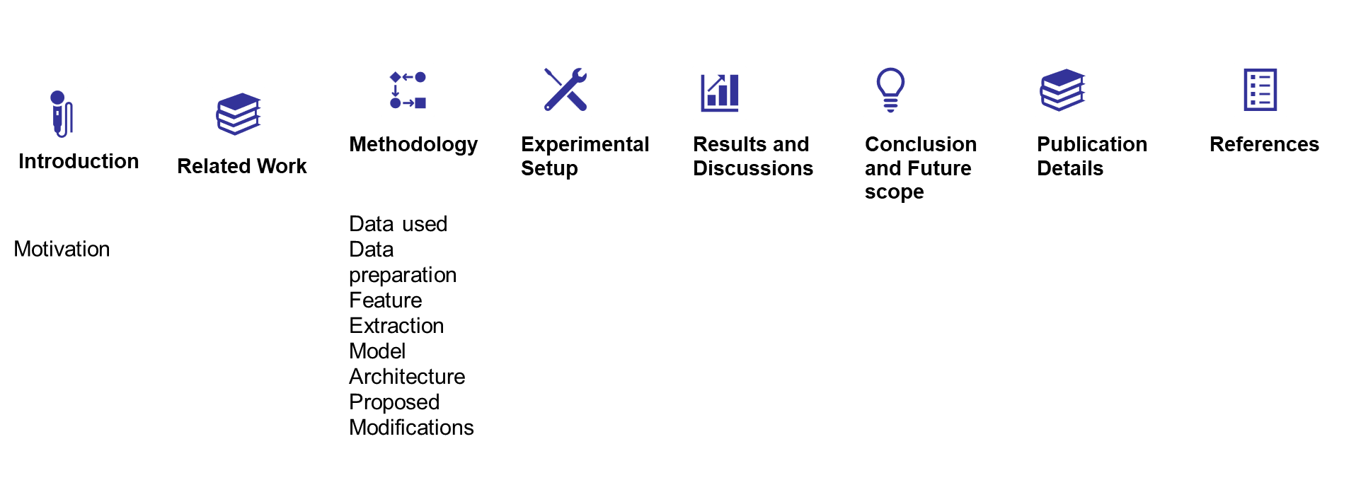
Problem Statement
Motivation
Literature Review
Contents
Contents

Slide 6
Contents
Contents
Problem Statement
Motivation
Literature Review

Slide 7
Problem Statement
To develop an AI-powered Question Paper Generator that automates the creation of customized, high-quality Bloom aligned question papers for educational institutions.

Slide 8
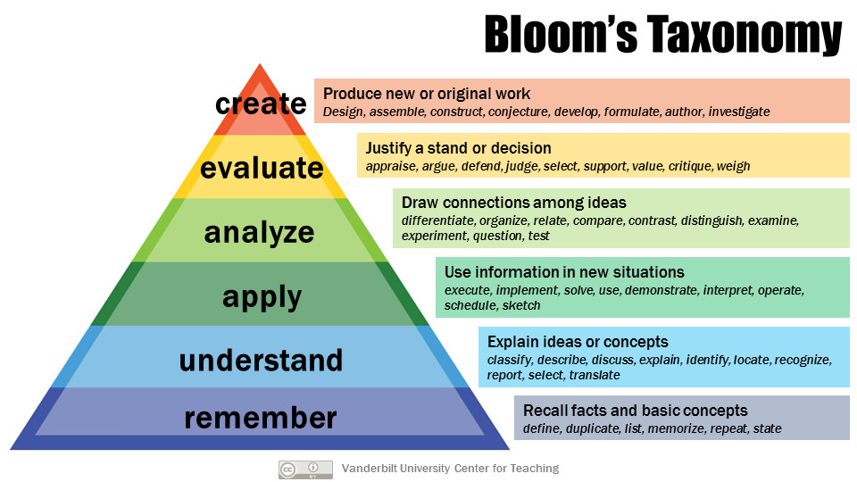

Slide 9
Motivation
Real-World Problem:
Manual question paper creation is time-consuming and error-prone.
No Bloom-level targeting or reusability in current systems.
Impact on Education:
Increases educator workload.
Affects student learning and also institutional efficiency.
Why This Project?:
Automates and customizes question paper generation (considering the factors).
Improves reusability and standardization.
Leverages AI and modern technologies.

Slide 10
Literature review
Title | Year | Method | Analysis
[1] Taxonomy of Educational Objectives: Cognitive Domain | 1956 | Proposed Bloom’s Taxonomy, classifying cognitive skills into Knowledge, Comprehension, Application, Analysis, Synthesis, and Evaluation. | - Standardized learning objectives and assessments. - Helped educators structure teaching effectively. - Became a fundamental tool in education.
[2] A Revision of Bloom's Taxonomy: An Overview | 2002 | Revised Bloom’s Taxonomy with action-oriented verbs and a two-dimensional framework (Cognitive Process & Knowledge Dimensions). | - Made the taxonomy more applicable to modern education. - Emphasized creativity and metacognition. - Supported 21st-century skills like critical thinking.
[3] Automated Educational Question Generation Using LLMs | 2023 | Evaluated LLMs (PaLM 2, Gemini Pro) for generating educational questions across Bloom’s Taxonomy levels. Compared human expert evaluations with automated assessments. | - LLMs generated high-quality questions across Bloom’s levels. - PaLM 2 outperformed others. - Highlighted discrepancies between human and automated evaluations.

Slide 11
Literature review
Title | Year | Method | Analysis
[4] An In-depth Look at Gemini's Language Abilities | 2021 | Benchmarked Gemini Pro vs. GPT-3.5 Turbo on 10 datasets (reasoning, QA, math, translation, etc.). Used zero-shot and few-shot prompting. | - Gemini Pro’s performance close to GPT-3.5 Turbo but slightly weaker. - Identified improvement areas like mathematical reasoning. - Provided reproducible benchmarks..
[5] Gemini in Reasoning: Commonsense in Multimodal LLMs | 2023 | Evaluated Gemini Pro on 12 datasets for commonsense reasoning in language-only and multimodal tasks. Used zero-shot SP and few-shot CoT prompting.. | - Competitive in language-only tasks vs. GPT-3.5 Turbo. - Struggled with multimodal tasks, esp. emotion detection in images. - CoT prompting consistently improved performance..
[6] Gemini: A Family of Highly Capable Multimodal Models | 2023 | Introduced Gemini models (Ultra, Pro, Nano) with text, images, audio, and video integration. Focused on multimodal reasoning. | - Enabled applications in conversational AI, content creation, and NL2SQL. - Improved cross-modal understanding. - Introduced Gemini 2.0 with native image/audio generation.

Slide 12
Literature review
Title | Year | Method | Analysis
[7] Attention Is All You Need | 2017 | Introduced Transformer architecture with self-attention instead of recurrence/convolution. Used multi-head attention, positional encoding, and feedforward networks. Trained on WMT 2014 English-German dataset.. | - Eliminated the need for RNNs/CNNs, enabling full parallelization. - Achieved SOTA results in machine translation. - Outperformed LSTMs and CNNs in handling long-range dependencies. - Laid the foundation for modern LLMs like BERT, GPT, and T5.
[8] BERT: Pre-training of Deep Bidirectional Transformers for Language Understanding | 2018 | Introduced Bidirectional Encoder Representations from Transformers (BERT). Used Masked Language Modeling (MLM) and Next Sentence Prediction (NSP). Pre-trained on BooksCorpus and English Wikipedia. | - Achieved SOTA results on 11 NLP tasks, including GLUE and SQuAD. - Demonstrated the effectiveness of bidirectional pre-training. - Open-sourced pre-trained models, enabling widespread NLP adoption.
[9] DeBERTa: Decoding-enhanced BERT with Disentangled Attention | 2020 | Introduced disentangled attention (separating word and positional embeddings) and enhanced masked decoder. Pre-trained on 160GB of text data. Fine-tuned on NLP benchmarks like GLUE and SuperGLUE. | - Outperformed BERT and RoBERTa on GLUE and SuperGLUE benchmarks. - Improved handling of word-position relationships. - Better generalization with fewer fine-tuning data requirements..

Slide 13
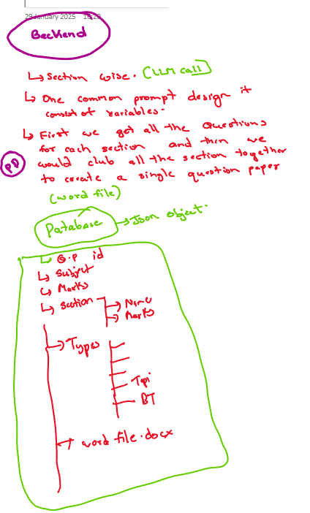
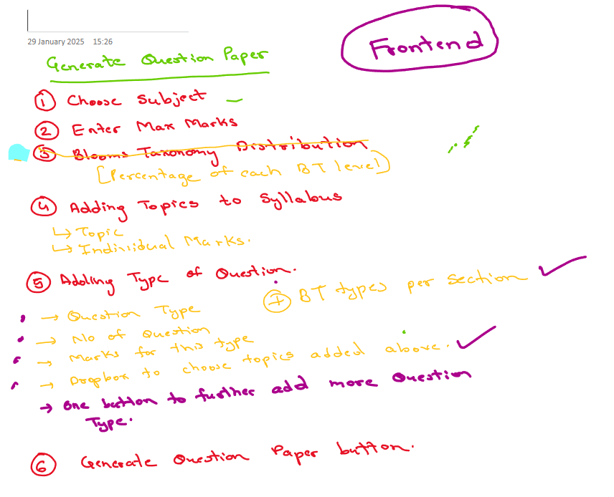
Objectives
Automated question paper generation:
1.1Develop an Effective UI/UX:
Designed an intuitive interface for
collecting user inputs (subject, year, topics, question types, etc.).

Slide 14
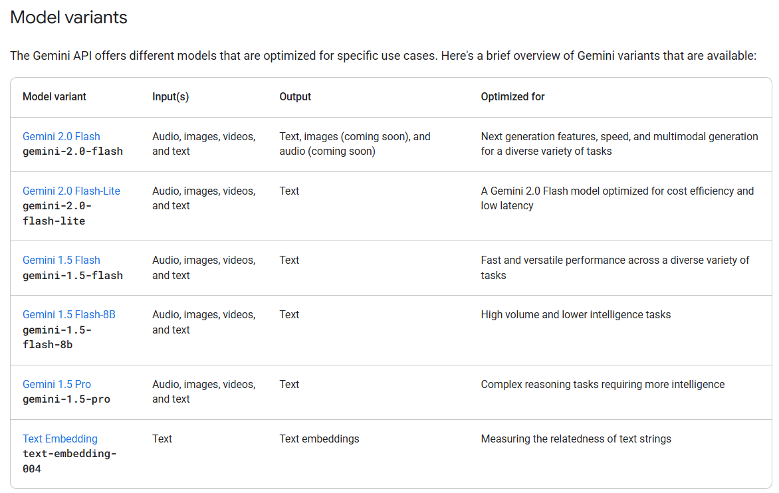
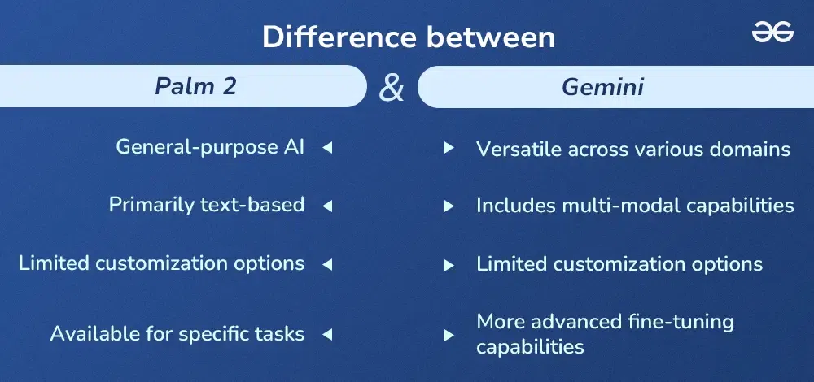
Objectives
Automated question paper generation:
1.2 Choose and Utilize LLM: Shifted from PaLM to Google Generative AI (Gemini) for better performance and integration.

Slide 15
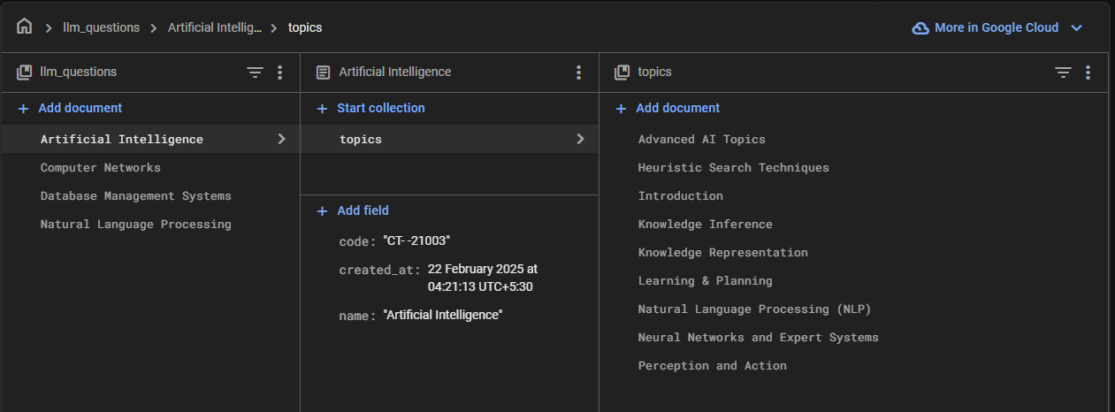
Objectives
2. Creating Heirerchial database structure
Add Syllabus and Extract Topics: Used AI to extract topics/subtopics and created the heirercial structure in firebase.
Store LLM-Generated Questions: Utilised the hierarchical Firestore database to store questions with metadata.

Slide 16
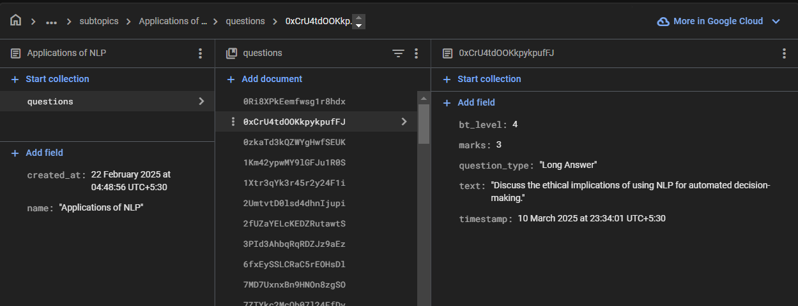
Objectives
3. Store Questions from Previous Year Papers:
Extracted text from PDFs using LlamaParse.
Processed text and deduced attributes for storage.
Stored questions in Firestore using hierarchical collections.

Slide 17
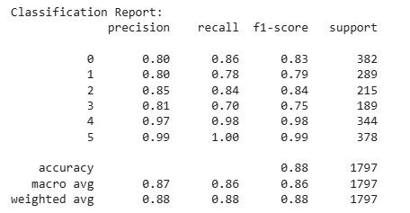
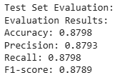
Objectives
4. Model to predict Bloom’s Taxonomy level
Model: Microsoft/deberta-v3-base (a pre-trained transformer model optimized for NLP tasks).
Dataset Size: (11,976, 2) → 11,976 training instances, each with two associated labels.

Slide 18
Objectives
5. Similarity check to avoid repetition:
Checking which questions are semantically similar to previous years’
6. Mix Questions from PYPs:
Integrate past questions into new papers.

Slide 19
Methodology
Module 1 — Smart Extraction & Hierarchical Storage
Module 2 — AI-Based Question Paper Generation
Module 3 — Validation & Redundancy Control

Slide 20
Methodology
Module 1 — Smart Extraction & Hierarchical Storage
Module 2 — AI-Based Question Paper Generation
Module 3 — Validation & Redundancy Control

Slide 21
Module 1 — Smart Extraction & Hierarchical Storage
PDF Extraction:
LamaParse + OCR
Metadata Deduction:
AI generates questions based on input parameters.
Storage:
Firestore hierarchical DB — subject → topic → subtopic → questions.
Mark Estimation + Type Detection:
Leveraging the capabilities of LLM.

Slide 22
Module 2 — AI-Based Question Paper Generation
User Input:
Educators input parameters (subject, topics, question types, etc.).
Question Generation:
AI generates questions based on input parameters.
Question Bank Management:
Questions stored in Firebase Firestore for future use.
Optimization:
Ensures even distribution and uniqueness of questions.
Export:
Question papers exported in PDF, DOCX, or TXT formats.

Slide 23
Module 3 — Validation & Redundancy Control
Bloom Adherence Validation:
To ensure the questions generated by LLM are of correct BT Level
Similarity Detection:
all-mpnet-base-v2 embeddings, cosine thresholds.
Green < 0.5 → Distinct
Yellow 0.5–0.8 → Moderate overlap
Red > 0.8→ Likely duplicate
Final Vetting:
Educator manual control over Bloom distribution and question regeneration.

Slide 24
Model to predict Bloom’s Taxonomy level
Model: Microsoft/deberta-v3-base (a pre-trained transformer model optimized for NLP tasks).
Dataset Size: (11,976, 2) → 11,976 training instances, each with two associated labels.

Slide 25
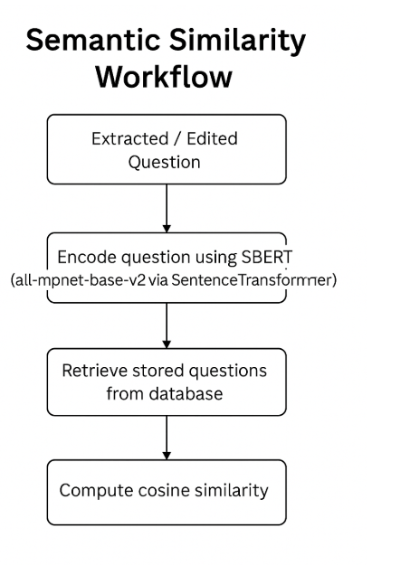
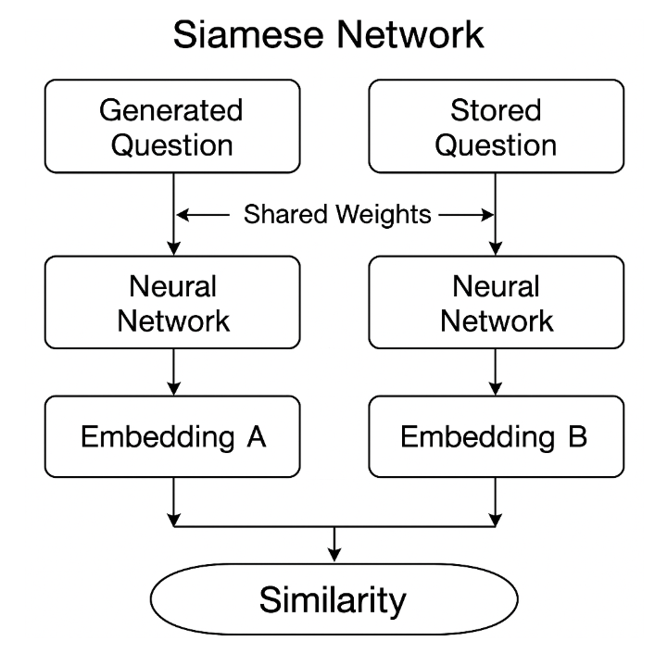
Model to predict Similarity
Model: all-mpnet-base-v2 (a pre-trained transformer model optimized for NLP tasks).

Slide 26
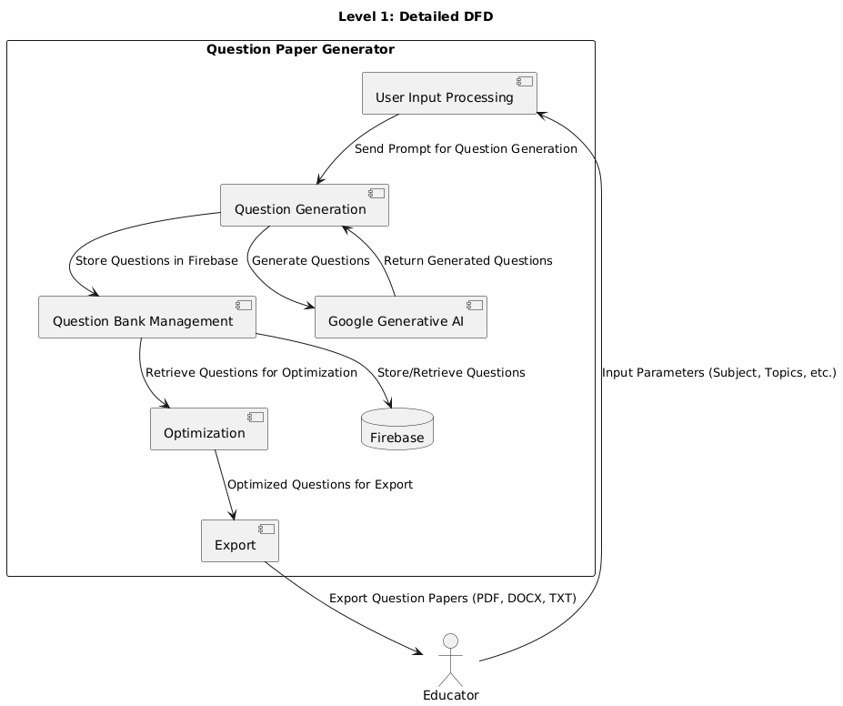
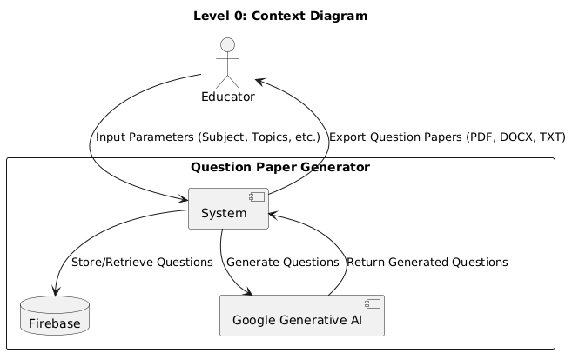
Data Flow

Slide 27
Experimental Setup
Hardware Specifications | Software Specifications
Processor: Intel Core i5 or equivalent. RAM: 8 GB or higher. Storage: 256 GB SSD. OS: Windows 10/11, macOS, or Linux. Internet: Stable broadband connection. | Frontend: HTML, CSS, JavaScript, Bootstrap. Backend: Flask, Firebase, Google Generative AI. Database: Firebase Firestore, Firebase Emulator Suite. File Handling: FPDF, python-docx.

Slide 28
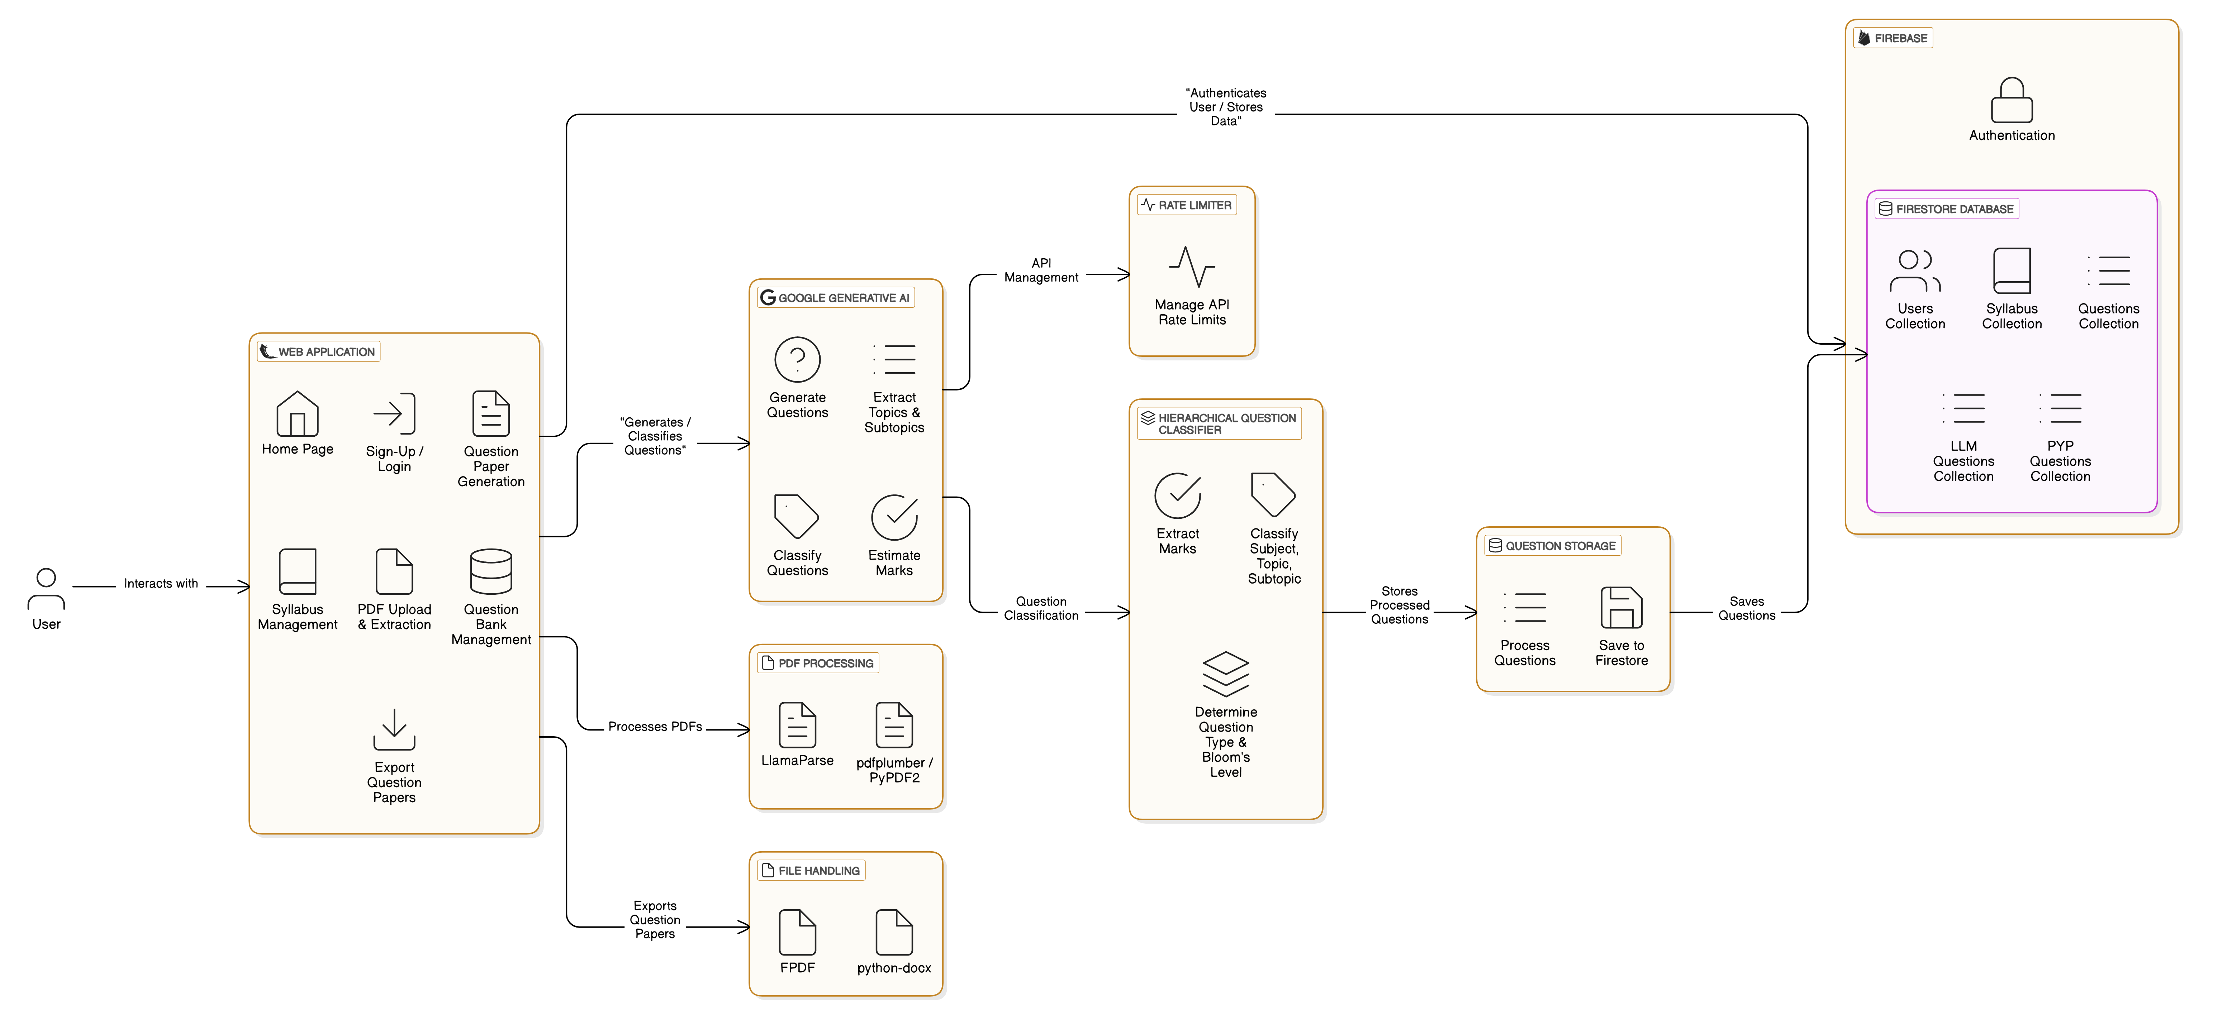
Architecture

Slide 29
Results and Discussion
Achievements:
Automated question paper generation using Google Generative AI.
Customization based on subject, topics, question types, and Bloom's Taxonomy.
Randomization for unique question papers.
Features Achieved:
User authentication (Firebase + Google Sign-In).Syllabus management and PDF extraction (LlamaParse).
Export functionality (PDF, DOCX, TXT).
Hierarchical question bank management.
Preliminary Results:
High-quality, customized question generation.
Positive feedback from educators.
Discussion:
Strengths:
Time-saving, customization, reusability.
Challenges:
Question quality, scalability, PDF extraction, llm response.
Future Improvements: Advanced question types, AI grading, analytics.

Slide 30
Future Scope
Advanced Question Types:
Diagram-based questions
code snippets
mathematical equations.
Enhanced AI Capabilities:
Context-aware question generation
multilingual support
adaptive learning.

Slide 31
References
[1] A. Vaswani, N. Shazeer, N. Parmar, J. Uszkoreit, L. Jones, A.N. Gomez, Ł. Kaiser, and I. Polosukhin, ”Attention is All You Need,” in Advances in Neural Information Processing Systems, vol. 30, 2017.
[2] J. Devlin, M. Chang, K. Lee, and K. Toutanova, ”BERT: Pre-training of Deep Bidirectional Transformers for Language Understanding,” arXiv preprint arXiv:1810.04805, 2018.
[3] P. He, X. Liu, J. Gao, and W. Chen, ”DeBERTa: Decoding-enhanced BERT with Disentangled Attention,” arXiv preprint arXiv:2006.03654, 2020.
[4] B. S. Bloom, M. D. Engelhart, E. J. Furst, W. H. Hill, and D. R. Krathwohl, Taxonomy of Educational Objectives: The Classification of Educational Goals, Handbook I: Cognitive Domain, David McKay Company, 1956.

Slide 32
References
[5] D. R. Krathwohl, ”A Revision of Bloom’s Taxonomy: An Overview,” Theory into Practice, vol. 41, no. 4, pp. 212–218, 2002.
[6] N. Scaria, S. D. Chenna, and D. Subramani, ”Automated Educa tional Question Generation at Different Bloom’s Skill Levels Using Large Language Models: Strategies and Evaluation,” arXiv preprint arXiv:2304.12345, 2023.
[7] M. Chindukuri and S. Sivanesan, ”Transfer Learning for Bloom’s Taxonomy-Based Question Classification in Educational Assessments,” Neural Computing and Applications, vol. 36, pp. 123–145, 2024.
[8] H. Sharma, R. Mathur, T. Chintala, D. Samiappan, and S. Ramalingam, ”An Effective Deep Learning Pipeline for Improved Question Clas sification and Generation Using Bloom’s Taxonomy,” Education and Information Technologies, vol. 28, pp. 5105–5145, 2023.

Slide 33
References
[9] S. N. Akter, Z. Yu, A. Muhamed, T. Ou, A. B¨ auerle, ´ A. A. Cabrera, K. Dholakia, C. Xiong, and G. Neubig, ”An In-Depth Look at Gemini’s Language Abilities,” arXiv preprint arXiv:2312.11444, 2023.
[10] Y. Wang and Y. Zhao, ”Gemini in Reasoning: Unveiling Com monsense in Multimodal Large Language Models,” arXiv preprint arXiv:2312.17661, 2023.
[11] Gemini Team Google, ”Gemini: A Family of Highly Capable Multi modal Models,” arXiv preprint arXiv:2312.11805, 2023

Slide 34


